Slide 1

Chapter 01: Business Ethics & Corporate Governance
06-10-2021
Class : Open Course 5th Sem | Subject : SML331 Business Environment And Corporate Strategy
Lectured By: Ashutosh Kumar Singh
Faculty, School of Commerce & Management,
Career Point University, Kota
‹#›

Slide 2
Title and Content Layout with List
06-10-2021
Class : Open Course 5th Sem | Subject : SML331 Business Environment And Corporate Strategy
Introduction of Business Environment
Dimensions of the BE
Importance of the BE
Components of the BE
External and Internal environment
External Environment: Demographic, Social, Cultural, Political, Economic, Financial, Trade, Technological, legal, regulatory, tax, ethical,
Internal Environment, strategy structure, marketing capability, operations capability, personal capability, financial capability, technical capability.
Meaning of Strategic Management
Role of SM
Process of SM
Limitations of SM
Organizational:
Mission
Vision
Goals
Ethics.

Slide 3
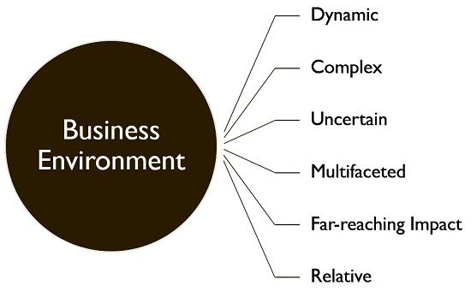
Introduction of Business Environment
06-10-2021
Class : Open Course 5th Sem | Subject : SML331 Business Environment And Corporate Strategy
The term 'business environment’ connotes external forces, factors and institutions that are beyond the control of the business and they affect the functioning of a business enterprise. These include customers, competitors, suppliers, government, and the social, political, legal and technological factors etc.

Slide 4
Dimensions of Business Environment
06-10-2021
Class : Open Course 5th Sem | Subject : SML331 Business Environment And Corporate Strategy
The Dimension or the agents that foster the formation of a business environment include Political, Social, Technological, Economic and Legal circumstances scrutinized accordingly for enhancing the achievement of trading concern and decision-making. In contrast to an explicit business environment, these factors manifest the predominating environment, which often impacts several companies at the same time.
Agencies
Commissions
Courts
Govt Authorities
Economic Policies
Rate of Inflation
Demand & Supply Chain
Parties
Government
Political Stability
Values
Traditions & Culture
Trends in the Social
Innovation
Techniques
Services
Goods
New Approach
Compatibility
Legal
Economic
Political
Social
Technological
Notes:
The Dimension or the agents that foster the formation of a business environment include Political, Social, Technological, Economic and Legal circumstances scrutinised accordingly for enhancing the achievement of trading concern and decision-making. In contrast to an explicit business environment, these factors manifest the predominating environment, which often impacts several companies at the same time.
The changing dimensions of the business environment influence the business environment like the investors, suppliers, competitors and even the customers. However, the administration of every business sector profits through one of the changing dimensions over unbiased behaviour. There are five general forces that effects and changes the dimensions of Business Environment:
Legal Environment
The Legal Business Environment includes several laws passed by the Government and the resolutions rendered by agencies, commissions, courts, government authorities and the local, state and central Government. Every business must hold a prerequisite legal understanding for the plain sailing of the business and industry functions and to avoid any legal tangle.
In a Legal Business environment, it is a must for every business to hold some knowledge of the laws like the Consumer Protection Act, 1986, Policies about Foreign Trade, Industrial Disputes Act, 1947, Companies Act, 2013, Policies relating to approvals and licences, Competition Act, 2002, and so on. For Example: Labour Law helps companies to stay away from penalties or It is mandated for Tobacco Companies to state its consequences on its product.
Economic Environment
The Economic Environment comprises Economic Conditions prevailing in the environment, Economic System and Economic policies in a business environment.
1. Economic Policies in Business Environment
To control the business environment, the Government meets a range of objectives like Predictability, Health and Safety and Stability. To combat the welfare of the public, Local, State and National policies are drafted that affect the planning and operations of the Business sectors profoundly. The economic Policies in the Business Environment direct the country’s economic activities like Public debt, Import and Export, Tax structure, Industry and so on.
2. Rate of Inflation
Inflation plays a vital role in fostering a better economic environment. Suppose the economy is booming with a constant business flourish and an increase in the purchasing power of the consumer. In that case, the producer can sell a commodity at a premium price in the market.
Whereas, during an economic depression, the purchasing or investing power of consumers topples and the producer has to re-establish the prices of the commodity.
3. Demand and Supply Chain
Businesses can foresee and identify potentially profitable opportunities that raise an incentive to the demand of a product followed by increased production. The demand and supply chain of a commodity influence the economic business environment excessively. The factor is highly dependent on the demand of a commodity and the producer’s ability to fabricate it on time.
Political Environment
The political factor is the most critical Dimension of a Business environment comprising external factors such as peace and political stability. It takes into consideration the ideology of the dominant political party in the country. Businesses function with the framework and nature of the predominating political party, which means that the actions initiated by the Government, potentially affect the activities and domestic products of companies or businesses at a global level.
A business’s success depends on the peace of the country, Government’s attitude towards the industry, and the stability of the Government, the constitution of the country, Political ideology, and the degree of Politicisation. For Example- The Political Stability and the Central Government’s attitude towards the industry, business, or employment has captivated several International and National entrepreneurs to invest in India.
Social Environment
The Social Environment comprises values, the standard of living, traditions, levels of education and more. All the forces hold a significant impact on the business sector of the country.
1. Values
Values refer to the social paradigm and the standard principles prevailing in society, such as Non-discriminatory practices, social justices, Equality, Freedom, etc. Organisations believe in the social values to maintain prominence in society and ease their way to sell products.
2. Traditions and Culture
Traditions and Culture refer to the social stigmas and practices enduring for decades in the country which influences the Businesses such as Christmas, Diwali, Ugadi, and Eid. An increase in demand during festive seasons provides opportunities for various businesses. Therefore, businesses should plan and strategise accordingly.
3. Trends in the Social Environment
Social trends are general development of change such as Fitness and Health trends in the society. The Fitness and Health trend in society has generated a great demand for mineral waters, gyms, etc.
Technological Environment
The technological environment comprises innovations and scientific improvements which foster updated techniques, renders services, produces goods and new approaches. A company needs to comprehend the various levels of scientific achievements of the economy before introducing a product. Technological compatibility of products also propels the demand for manufactured products by a company. For Example, E-Commerce has transposed the Business game, the buying and availing of services through Digital platform, and the Digital India initiative to metamorph into a better society.

Slide 5
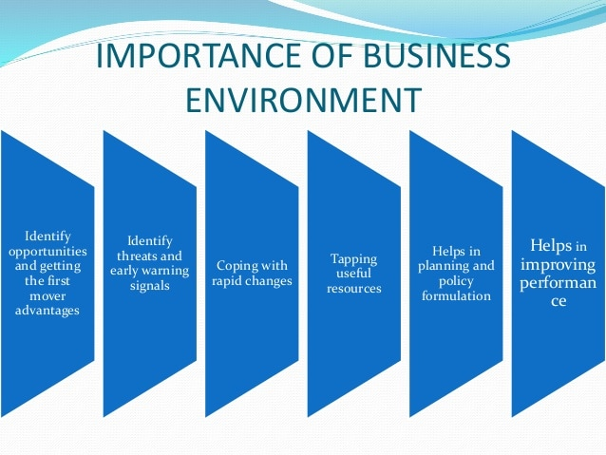
Importance of Business Environment
06-10-2021
Class : Open Course 5th Sem | Subject : SML331 Business Environment And Corporate Strategy
In any business, it is important to be aware of the actions and strategies of your competitors. A business environment enables firms to analyze their competitors' strategies and actions. Further, they can create their own strategies accordingly.
Notes:
3. Identify Opportunities And Getting The First Mover Advantages Environment provides numerous opportunities for business men. Early identification of opportunities helps an enterprise to be the first to exploit them.
4. Identify threats and early warning signals Threats refer to the changes in external environment that may affect the performance of the business. Environment awareness can help mangers to identify various threats on time and serve as a warning signal.
5. Helps in coping with rapid changes are taking place rapidly in today’s business environment .In order to adjust with the changes ,managers must understand and examine the environment and develop suitable course of action.
6. Helps in tapping useful resources Environment is a source of various resources for running a business. All business enterprise collects inputs form the environment and supplies its output for the customers.
7. Helps in assisting in planning and policy formulation Environment provides inputs for effective planning and decision making. Business enterprise can formulate policies on the basis of the information they collected by studying the environment.
8. Helps in improving performance The future of any organization largely relates to its ability to make changes according to changes in business environment. Thus environmental analysis helps them to improve their performance.

Slide 6
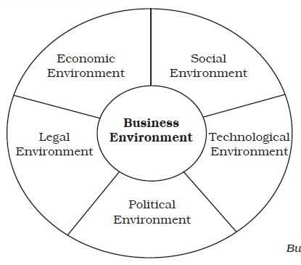
Components of Business Environment
06-10-2021
Class : Open Course 5th Sem | Subject : SML331 Business Environment And Corporate Strategy
Every member or institution which affects, or is affected by the business is an element of the environment of the business. The elements or components of the business environment are grouped or classified by different scholars in different ways. An entrepreneur by any promising investment idea exploits the opportunities in the environment and must assess his comities. Promising entrepreneur of manager should continuously forecast and appraise the environment to be successful and effective in the competitive environment. Below, a classification of the environmental factors has been presented.
Notes:
Socioeconomic Factors
Economic and 2psociety environment or socio factors of the environment are very impotent for on. Every wants to earn wants through business operation. Knowledge of the socio environment and skill to analyze and of the environment affects the success of any entrepreneur.
Social factors including the socio– cultural attitudes, education, aspirations and desires, beliefs and customs. Social values and norms, social groups and institutions, historical background , cultural heritage, population growth, attitudes towed woman deduction and employment, age shifts in population, the conservativeness or rigidity in human behavior, attitudes toward saving and, consumption of refulgence in human social economic and environmental variables for an entrepreneur to be considered in business planning.
After social factor, economic factors are important for the management of the business. Economic factor including all economic variable or features of any economy, especially , state of the economy, annual growth rate, economic system, economic philosophy, cyclical flections q inflation rated and balance of payment, economic policy, economic condition and economic relations etc.
A country may be poor or rich; developing, underdeveloped or developer. The natural resources base, educational developments technical know-how, per-captain income balance of trade, bank and other financial institutions, etc. may be favorable or unfavorable. for any business operation. Hence , socio-economic condition assists the business operation to a great extent. If socio-economic is not favorable, then business development may be hampered.Components of Business Environment
Government and Political Factor
The philosophy, sincerity of the government affects the business to a great extent. In international arena today for gain investment is a mode of rapid development. Today, the policies of some government can attract for gain investment may, while that of others cannot .Government by its framework or fiscal policy monetary policy, export and import policies policy programs subsidies affects the operation and success of the business. Government’s sincere and hearty patronage accelerates the business and economic development of any country.
Political system, public opinion, democracy, government attitude toward political freedom of press, personal liberty, transparent political etc affect business development. Business should follow existing norm, and try to develop the prevailing system.
Technological Factors
Today business is very competitive. Improved technology reduces product’s cost and increase profit. Butter technology in the competitor’s hand may make one’s technology obsolete and lees viable. Emergencies of new technology, access to indigenous or foreign technical know are very challenging factors for the entrepreneur. Japan is an economic superpower in the world, because of her improved technology, managerial knows how and hard working attribution of the Japanese. India follows a protection oriented economic policy and tries to develop indigenous technology. Bangladesh depends heavily on import, which is an impediment to developed of indigenous technology.
Supply and Cooperation Factors
Business processes raw materials to product finished goods. So availability of raw materials, abundance of natural resources, uninterrupted supply of raw materials and suppliers affect the success survival and existence of the business. Favorability natural resources cause business envelope. A violability of raw jute helped the establishment of the “Adamjee jute Mill ” the biggest jute mill in the world, in Bangladesh, now shut down and Narayangonj, a repower the just trading center of Bangladesh, was called the Dundee of the east during the British period. The petroleum caused the development of petro-chemical indirectly and business in the Arabian Peninsula. So the availability of raw materials and its cost, availability of raw materials and its cost availability and cost of energy availability and cost of money influence and affect the business decisions and operations. Competition is important in the business environment. Competition enhances skills, but makes survival of the business challenging. The marketing policies and practices, the entry barriers, the degree of the different ion and homogeneity of products, the availability of substitute and complement goods the competitors policies and strategies, the government’s awareness and attitude to control malpractice in the competition, etc . Constitute the completion factors in the environment and affect business operation and development.
Other Factors
Legal framework n also impotent factors in the business environment. The legal heritages, the laws of the land, the sincerity and enforcing agencies, etc., are also important factors of the environment. The physical infrastructure., and the, road, bridge, transportation, telecommunication, etc, and the financial infrastructure banking company, insurance house, money market and capital market or stock exchanges the instruments in the financial market and the marketability of those; the religious patience, politeness of the public sentiment, etc ., cause the environment favorable or unfavorable for the business. Thus environment factors affect and contribute to the development and sustainability of the business in any region.

Slide 7
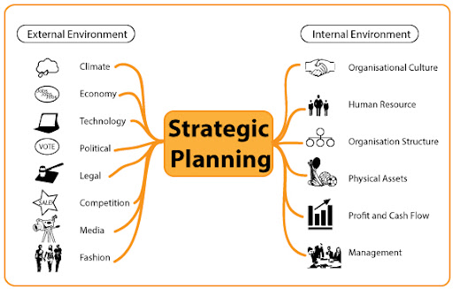
Internal & External Environment
06-10-2021
Class : Open Course 5th Sem | Subject : SML331 Business Environment And Corporate Strategy
For any business to grow and prosper, managers of the business must be able to anticipate, recognise and deal with change in the internal and external environment. Change is a certainty, and for this reason business managers must actively engage in a process that identifies change and modifies business activity to take best advantage of change. That process is strategic planning.
The following diagram provides examples of factors that are agents of change and need to be considered in the strategic planning process.
Notes:
While some of these factors or forces may have direct influence over the business firm, others may operate indirectly. Thus, business environment may be defined as the total surroundings, which have a direct or indirect bearing on the functioning of business. It may also be defined as the set of external factors, such as economic factors, social factors, political and legal factors, demographic factors, and technical factors etc., which are uncontrollable in nature and affects the business decisions of a firm. • Business Environment has been defined by Bayard O. Wheeler as “the total of all things external to firms and industries which affect their organization and operation”. • According to Arthur M. Weimer, business environment encompasses the ‘climate’ or set of conditions, economic, social, political or institutional in which business operations are conducted. • According to Glueck and Jauch, “The environment includes factors outside the firm which can lead to opportunities for or threats to the firm. Although there are many factors, the most important of the sectors are socio-economic, technological, supplier, competitors, and government.” • According to Barry M. Richman and Melvgn Copen “Environment consists of factors that are largely if not totally, external and beyond the control of individualÂ industrial enterprise and their managements. These are essentially the ‘givers’ within which firms and their management must operate in a specific country and they vary, often greatly, from country to country”. From the above definitions we can extract that business environment consists of factors that are internal and external which poses threats to a firm or these provide opportunities for exploitation.
While some of these factors or forces may have direct influence over the business firm, others may operate indirectly. Thus, business environment may be defined as the total surroundings, which have a direct or indirect bearing on the functioning of business. It may also be defined as the set of external factors, such as economic factors, social factors, political and legal factors, demographic factors, and technical factors etc., which are uncontrollable in nature and affects the business decisions of a firm.
• Business Environment has been defined by Bayard O. Wheeler as “the total of all things external to firms and industries which affect their organization and operation”.
• According to Arthur M. Weimer, business environment encompasses the ‘climate’ or set of conditions, economic, social, political or institutional in which business operations are conducted.
• According to Glueck and Jauch, “The environment includes factors outside the firm which can lead to opportunities for or threats to the firm. Although there are many factors, the most important of the sectors are socio-economic, technological, supplier, competitors, and government.”
• According to Barry M. Richman and Melvgn Copen “Environment consists of factors that are largely if not totally, external and beyond the control of individualÂ industrial enterprise and their managements. These are essentially the ‘givers’ within which firms and their management must operate in a specific country and they vary, often greatly, from country to country”. From the above definitions we can extract that business environment consists of factors that are internal and external which poses threats to a firm or these provide opportunities for exploitation.
Concept of Business Environment
A business firm is an open system. It gets resources from the environment and supplies its goods and services to the environment. There are different levels of environmental forces. Some are close and internal forces whereas others are external forces. External forces may be related to national level, regional level or international level. These environmental forces provide opportunities or threats to the business community. Every business organization tries to grasp the available opportunities and face the threats that emerge from the business environment. Business organizations cannot change the external environment but they just react. They change their internal business components (internal environment) to grasp the external opportunities and face the external environmental threats. It is, therefore, very important to analyze business environment to survive and to get success for a business in its industry. It is, therefore, a vital role of managers to analyze business environment so that they could pursue effective business strategy. A business firm gets human resources, capital, technology, information, energy, and raw materials from society. It follows government rules and regulations, social norms and cultural values, regional treaty and global alignment, economic rules and tax policies of the government. Thus, a business organization is a dynamic entity because it operates in a dynamic business environment.
Features of Business Environment
On the basis of the above discussion the features of business environment can be summarized as follows
Business environment is the sum totals of all factors external to the business firm and that
greatly influence their functioning.
• It covers factors and forces like customers, competitors, suppliers, government, and the
social, cultural, political, technological and legal conditions.
• The business environment is dynamic in nature that means, it keeps on changing.
• The changes in business environment are unpredictable. It is very difficult to predict the
exact nature of future happenings and the changes in economic and social environment. .
• Business Environment differs from place to place, region to region and country to country

Slide 8
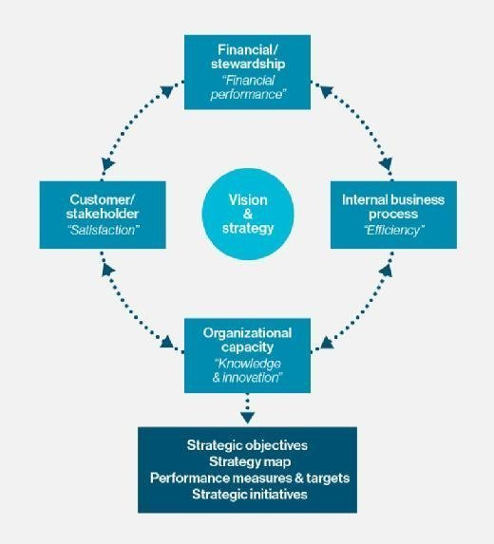
Meaning of Strategic Management
06-10-2021
Class : Open Course 5th Sem | Subject : SML331 Business Environment And Corporate Strategy
Strategic management is the ongoing planning, monitoring, analysis and assessment of all necessities an organization needs to meet its goals and objectives. Changes in business environments will require organizations to constantly assess their strategies for success. The strategic management process helps organizations take stock of their present situation, chalk out strategies, deploy them and analyze the effectiveness of the implemented management strategies. Strategic management strategies consist of five basic strategies and can differ in implementation depending on the surrounding environment. Strategic management applies both to on-premise and mobile platforms.
Notes:
Benefits of strategic management
Strategic management is generally thought to have financial and nonfinancial benefits. A strategic management process helps an organization and its leadership to think about and plan for its future existence, fulfilling a chief responsibility of a board of directors. Strategic management sets a direction for the organization and its employees. Unlike once-and-done strategic plans, effective strategic management continuously plans, monitors and tests an organization's activities, resulting in greater operational efficiency, market share and profitability.
Strategic management concepts
Strategic management is based around an organization's clear understanding of its mission; its vision for where it wants to be in the future; and the values that will guide its actions. The process requires a commitment to strategic planning, a subset of business management that involves an organization's ability to set both short- and long-term goals. Strategic planning also includes the planning of strategic decisions, activities and resource allocation needed to achieve those goals.
Having a defined process for managing an institution's strategies will help organizations make logical decisions and develop new goals quickly in order to keep pace with evolving technology, market and business conditions. Strategic management can, thus, help an organization gain competitive advantage, improve market share and plan for its future.
Five stages of strategic management process
There are many schools of thought on how to do strategic management, and academics and managers have developed numerous frameworks to guide the strategic management process. In general, the process typically includes five phases:
Assessing the organization's current strategic direction;
Identifying and analyzing internal and external strengths and weaknesses;
Formulating action plans;
Executing action plans; and
Evaluating to what degree action plans have been successful and making changes when desired results are not being produced.
Effective communication, data collection and organizational culture also play an important part in the strategic management process -- especially at large, complex companies. Lack of communication and a negative corporate culture can result in a misalignment of the organization's strategic management plan and the activities undertaken by its various business units and departments. (See Value of organizational culture.) Thus, strategy management includes analyzing cross-functional business decisions prior to implementing them to ensure they are aligned with strategic plans.

Slide 9
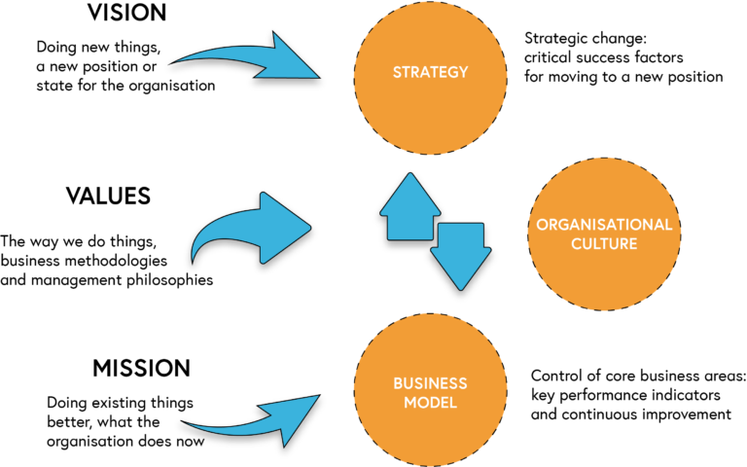
Organization: Mission, Vision, Ethics & Goal
06-10-2021
Class : Open Course 5th Sem | Subject : SML331 Business Environment And Corporate Strategy
Vision and mission both relate to an organization’s purpose and are typically communicated in some written form. Vision and mission are statements from the organization that answer questions about who we are, what do we value, and where we’re going.
Vision and mission create a target for strategy development. Vision and mission provide a high level guide, and the strategy provides a specific guide, to the goals and objectives showing success or failure of the strategy and satisfaction of the larger set of objectives stated in the mission.
Notes:
There are three reasons why an organization must develops vision and mission statements as shown above. First it helps the organization focus on what is really important. Although the organization knows what it is trying to do to improve the performance, yet it is easy to lose sight of this when dealing with the day to day hassles that plague all organizations. The vision and mission statements of the organizations help employees remember what is important as they go about doing their daily work.
Second, organizational vision and mission statements let people and other organizations have a snapshot view of what the organization is and what it wants to do. When the organizational vision and mission statements are easily visible, people can learn about the organization without having to work hard for the information. Then, those with common interests can take the time necessary to learn more.
Finally, vision and mission statements are also very helpful in having employees who are focused and bound together in common purpose. Not only do the statements themselves serve as a constant reminder of what is important to the organization, the process of developing them allows people to see the organization as “theirs.” It is common sense: people will believe in something more completely if they had a hand in developing it.
There are also many other reasons to develop vision and mission statements. For example having clear and compelling vision statements can (i) draw people to common work, (ii) give hope for a better future, (iii) inspire employees to realize their dreams through positive, effective action, and (iv) provide a basis for developing the other aspects of organizational action planning process such as organizational objectives, strategies, and action plans
In any organization the vision, mission, vision, values along with goals and objectives are the important areas even though these are major areas in themselves. Vision, mission, and values are critical to what the employees do in the workplace and how they do it.
An employee may be less familiar with the process of developing vision, mission, and values in the organization than he is with formulating goals and objectives. Even though employees often see vision and mission statements posted on workplace walls and printed in various organizational materials, they tend to pay little attention to them and view them as part of the routine. If the employees are not involved in the process of development of the vision, mission and values then they tend not to give them much attention as they go about their daily work.
An organizations experiences success in team building and in its business if (i) it has clearly defined organizational vision, mission, and values, (ii) it has clearly articulated the vision, mission, and values, to everyone involved with the business, and (iii) it has meshed the organization’s vision, mission, and values, into those of each individual employee so that in achieving individual goals and objectives, organization’s goals and objectives are also achieved.
Vision
Vision differs from mission in that it is future oriented. A vision typically addresses where the organization wants to be after a number of years. The vision statement of an organization sets a dynamic and compelling view of the organization at some point in the future. It is an emotional driver to some ‘big idea’ or challenge that drives employees in the organization toward it. It is not intended for the people outside the organization. It is not a goal but rather it can be a wild, crazy, and even unattainable idea, as long as it provides a deeply emotional drive to accomplish something great that employees in the organization can get behind and drive toward.
Vision statements reflect the ideal image of the organization in the future. The vision statement communicates both the purpose and values of the organization. For employees, it gives direction about how they are expected to behave and inspires them to give their best. Shared with customers, it shapes customers’ understanding of why they should work with the organization.
The vision statement usually has the following characteristics.
Understood and shared by members of the community
Broad enough to include a diverse variety of local perspectives
Inspiring and uplifting to everyone involved in the effort
Easy to communicate
The following issues are important for an organization while developing its vision statement.
The vision statement includes vivid description of the organization as it effectively carries out its operations.
Developing a vision statement can be quick culture specific, i.e., organizations may use methods ranging from highly analytical and rational to highly creative and divergent, e.g., focused discussions, divergent experiences around daydreams, sharing stories, etc. Therefore, views of the employees, how they might like to arrive at description of their organizational vision, are important.
Developing the vision can be the most enjoyable part of planning, but the part where time easily gets away from you.
Originally, the vision used to be a compelling description of the state and function of the organization once it had implemented the strategic plan, i.e., a very attractive image toward which the organization was attracted and guided by the strategic plan. Recently, the vision has become more of a motivational tool, too often including highly idealistic phrasing and activities which the organization cannot realistically aspire.
Mission
A mission statement communicates the organization’s reason for being, and how it aims to serve its key stakeholders. It is the organization’s purpose and values to all its key stakeholders. Stakeholders are those key parties who have some influence over the organization or stake in its future. Customers, employees, and investors are the stakeholders most often emphasized, but other stakeholders like government or communities can also be discussed. Mission statements are often longer than vision statements. Sometimes mission statements also include a summation of the organization’s values. Having a clear mission statement can:
Convert the broad dreams of the vision into more specific, action oriented terms
Explain the organizational goals to interested parties in a clear and concise manner
Enhance the organization’s image as being competent and professional, thus reassuring funding sources that their investment was a smart choice
Mission statements are similar to vision statements, in that they, too, look at the big picture. However, they are more concrete, and they are definitely more ‘action-oriented’ than vision statements. Organizational vision statement should inspire employees to action and to dream. Some general guiding principles about mission statements are given below.
Concise – While not as short as vision statements, mission statements generally should get their points across in a concise way.
Outcome oriented – Mission statements explain the fundamental outcomes for which the organization is working to achieve.
Inclusive – While mission statements do include statements about the organizational key goals, it is important that they do so very broadly.
The mission is a broad statement of business scope, purpose and operation that distinguishes the organization from other organization. It defines the organization’s purpose and primary objectives. It defines what the organization does, who it serves, and how it serves (creates value for) its clients. It is designed to provide clarity of focus and direction for the employees in the organization. It also creates clarity of value for those outside the organization and answers the question of whether this organization can be of value to them and/or their organization.
The prime function of the mission statement is internal – to define the key measure or measures of the organization’s success – and its prime audience is the leadership team and stockholders. Mission statement is the starting point of the organization’s strategic planning and goal setting process. It focuses attention and assures that internal and external stakeholders understand what the organization is attempting to accomplish.
Mission has external orientation and relates the organization to the society in which it operates. A mission statement helps the organization to link its activities to the needs of the society and legitimize its existence. Purpose is also externally focused but it relates to that segment of the society to which it serves; it defines the business which the institution will undertake.
According to Bart, the strongest organizational impact occurs when mission statements contain the following seven essential dimensions.
Key values and beliefs
Distinctive competence
Desired competitive position
Competitive strategy
Compelling goal/vision
Specific customers served and products or services offered
Concern for satisfying multiple stakeholders
According to Vern McGinis, a mission statement should include the following.
Define what the organization is
Define what the organization to be
Limited to exclude some ventures
Broad enough to allow for creative growth
Distinguish the organization from all others
Serve as framework to evaluate current activities
Stated clearly so that it is understood by all
The following elements can be included in a mission statement. Their sequence can be different. It is important, however, that some elements supporting the accomplishment of the mission be present and not just the mission as a ‘wish’ or dream.
Purpose and values of the organization (products or services, market) or who are the organization’s primary ‘clients’ (stakeholders)
What are the responsibilities of the organization towards these ‘clients’
What are the main objectives supporting the organization in accomplishing its mission
The business mission statement of the organization reflects the core values and beliefs of the individuals who lead the business. To the extent there are large differences between the organizational mission and an employee’s mission, or between organizational business values and employee’s core values, there will be discord and friction for that employee within the organization. In order to assure happiness and fulfillment at work it is necessary that employee’s values and mission are in alignment with those of the organization. Employees have been known to become physically ill from the stress of working in an organization where their core values are at odds with the values and ethics practiced in the organization. In addition to giving structure and direction to an individual or business, well written mission statements are excellent tools to inform all stakeholders what is important and how the business is being operated.
Values
Value statements define the organization’s basic philosophy, principles and ideals. They also set the ethical tone for the institution. An organization’s values are evident in the statements that define the organization and the processes used to achieve its mission and vision.
Values represent the core priorities in the organization’s culture, including what drives employees’ priorities and how they truly act in the organization, etc. Values are increasingly important in strategic planning. They often drive the intent and direction for ‘organic’ planners.
Developing a values statement can be quick culture specific, i.e., participants may use methods ranging from highly analytical and rational to highly creative and divergent, e.g., focused discussions, divergent experiences around daydreams, sharing stories, etc. Therefore, visit with the participants how they might like to arrive at description of their organizational values.
Normally four to six core values are established from which the organization would like to operate. Values of customers, shareholders, employees and the community are to be considered while establishing the core values of the organization.
If any difference is noticed between the organization’s preferred values and its true values (the values actually reflected by employees’ behaviours in the organization) then actions are incorporated into the strategic plan to align actual behaviour with preferred behaviours.

Slide 10
Thank You

